Slide 1
Discover the role of Python in space exploration
Abhigya Verma Microsoft Learn Student Ambassador Alpha

Slide 2
Session 3: Write basic Python in Notebooks in Visual Studio Code Learn the basics of Python.
Abhigya Verma Microsoft Learn Student Ambassador Alpha

Slide 3
Learning objectives
In this module, you will learn:
How and when to use comments
How to use math in Python
How to create variables
How to use pre-made functions
How to output data

Slide 4
Prerequisites
Visual Studio Code with Python installed

Slide 5
Add comments to Python Notebooks to add clarity to your code

Slide 6
What are comments?

Slide 7
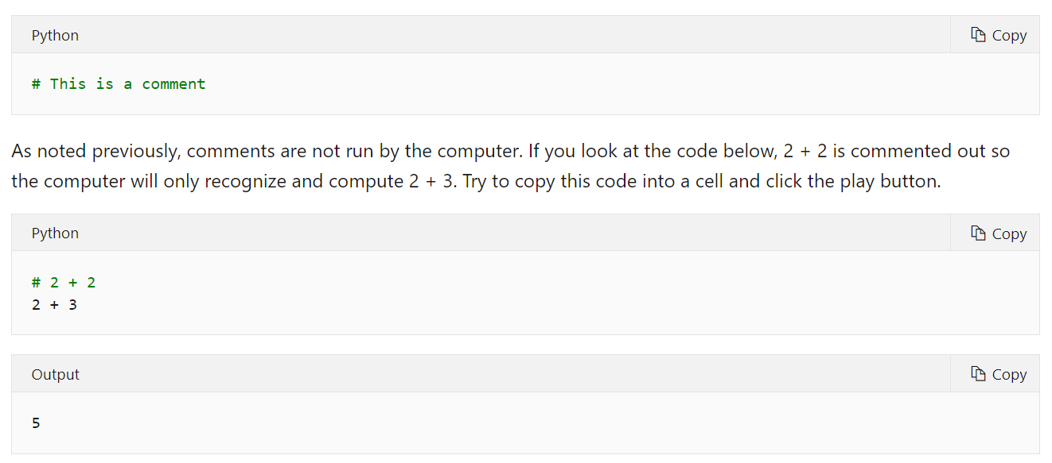
How to use comments?

Slide 8
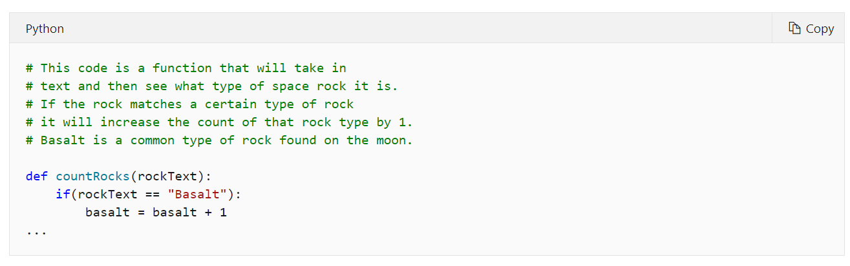
Block comments

Slide 9
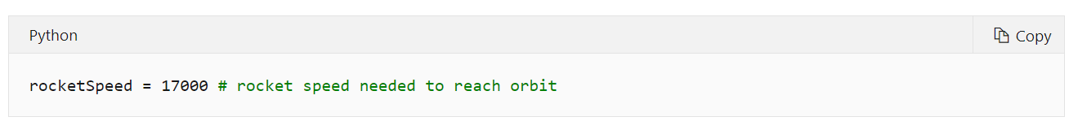
Inline comments

Slide 10
Code basic arithmetic in Python for future data analysis

Slide 11
Simple calculations

Slide 12
More advanced math

Slide 13
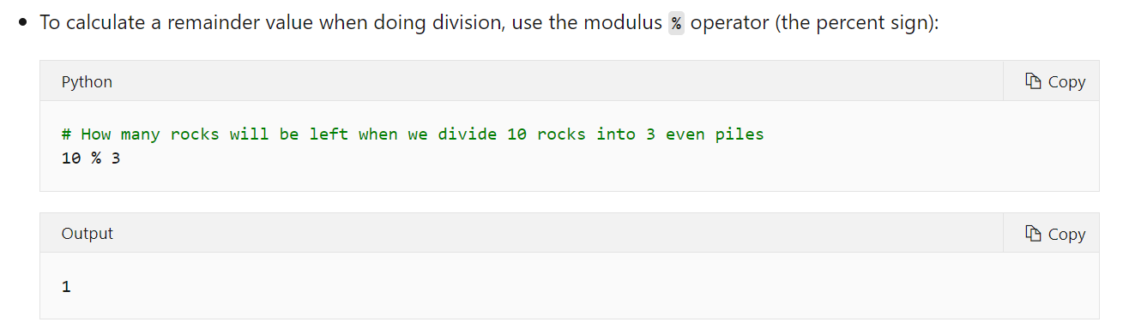

Slide 14
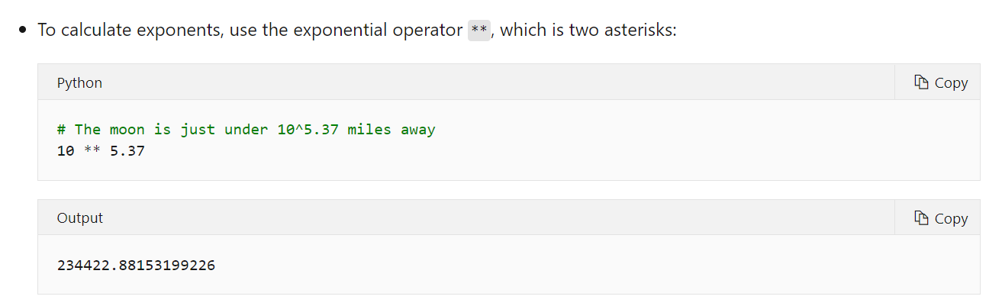

Slide 15
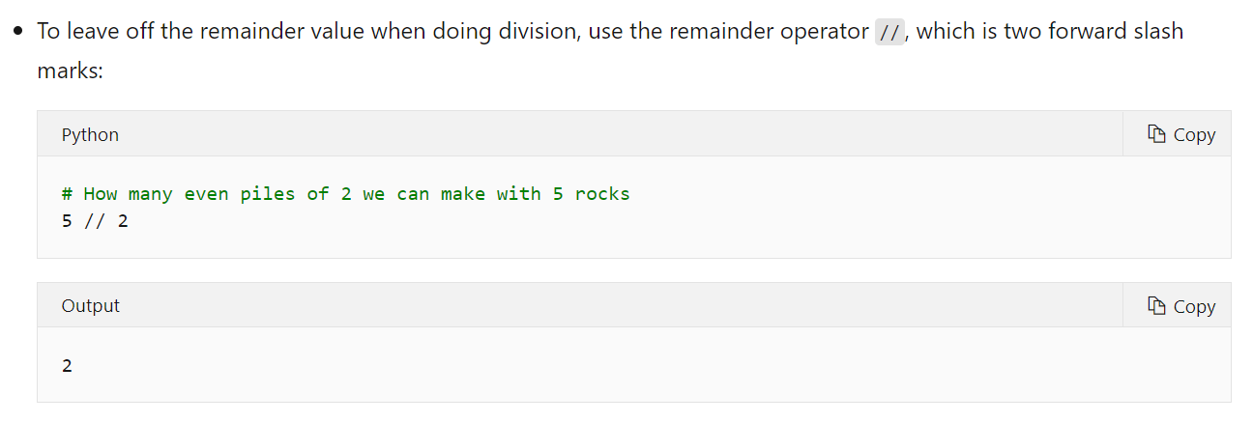

Slide 16
Create variables in Python Notebooks for future data analysis

Slide 17
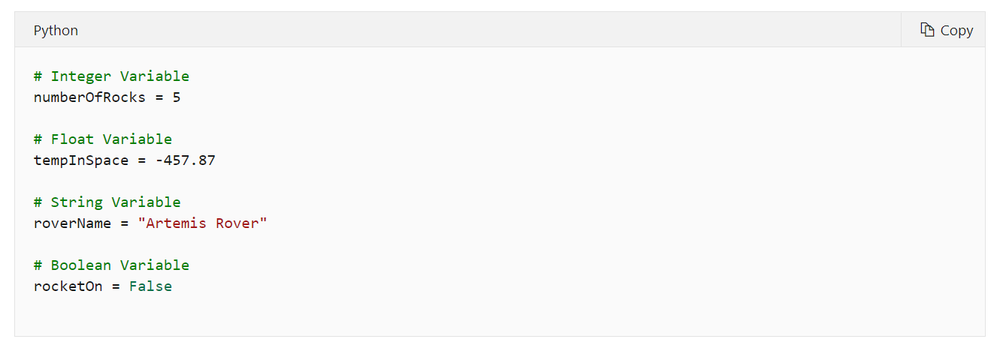

Slide 18
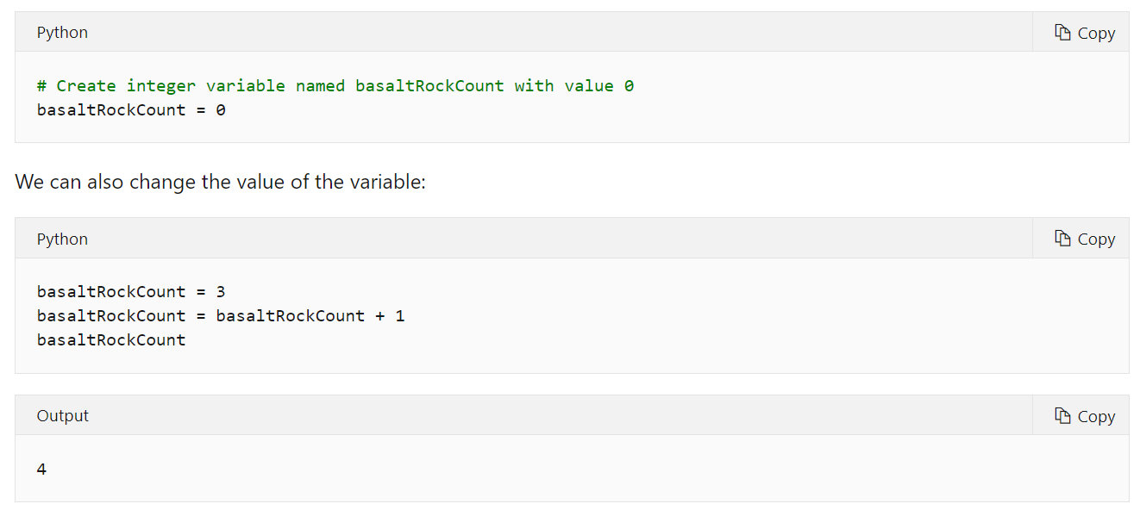

Slide 19
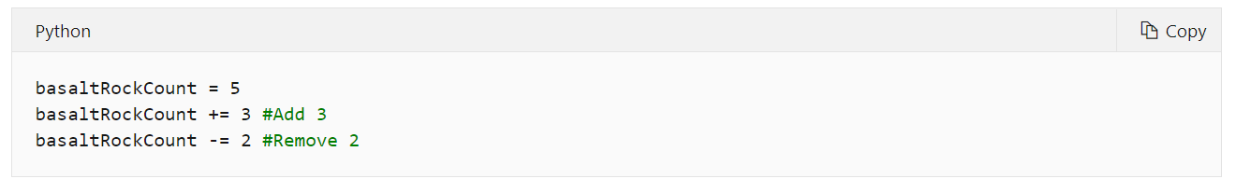
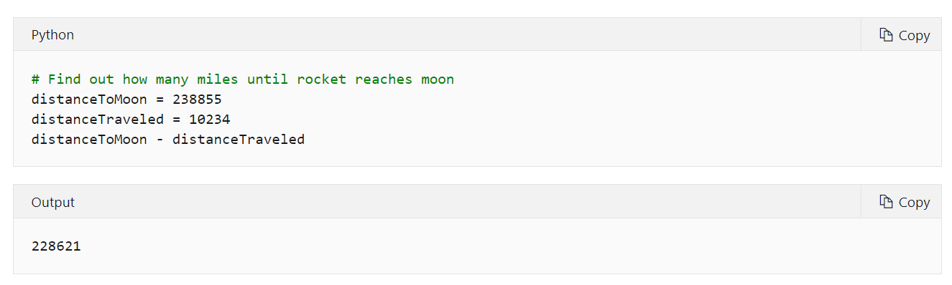

Slide 20
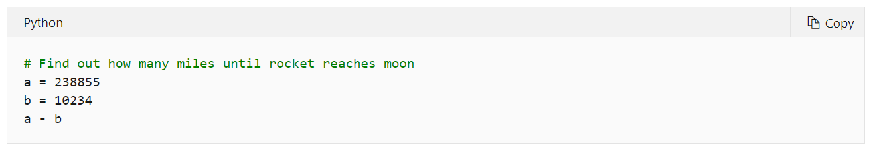

Slide 21
Create and manipulate text in Python code

Slide 22
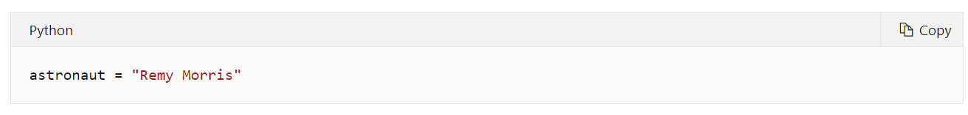
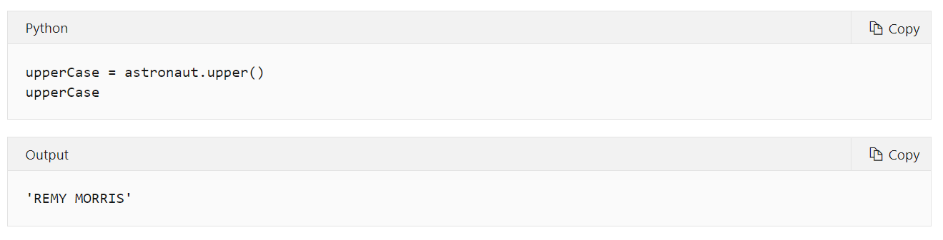

Slide 23
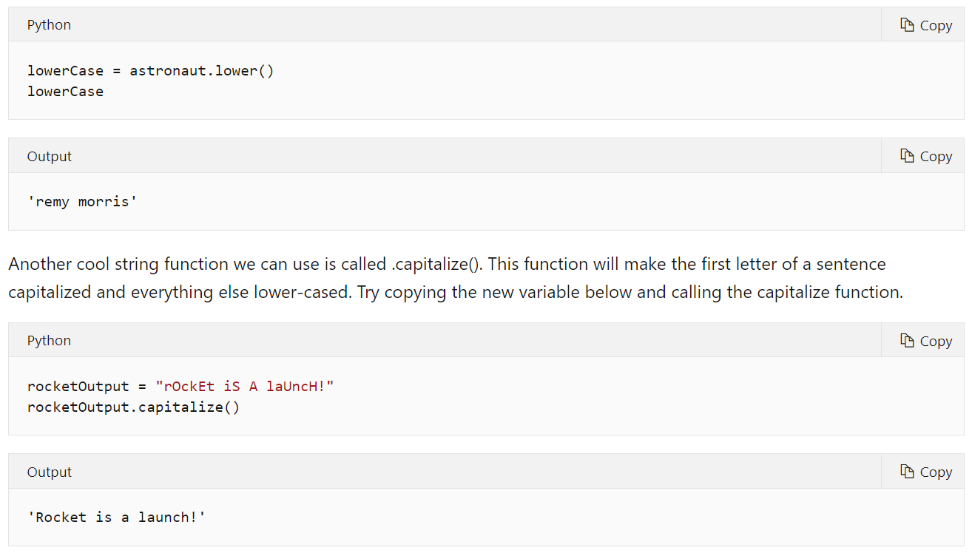

Slide 24
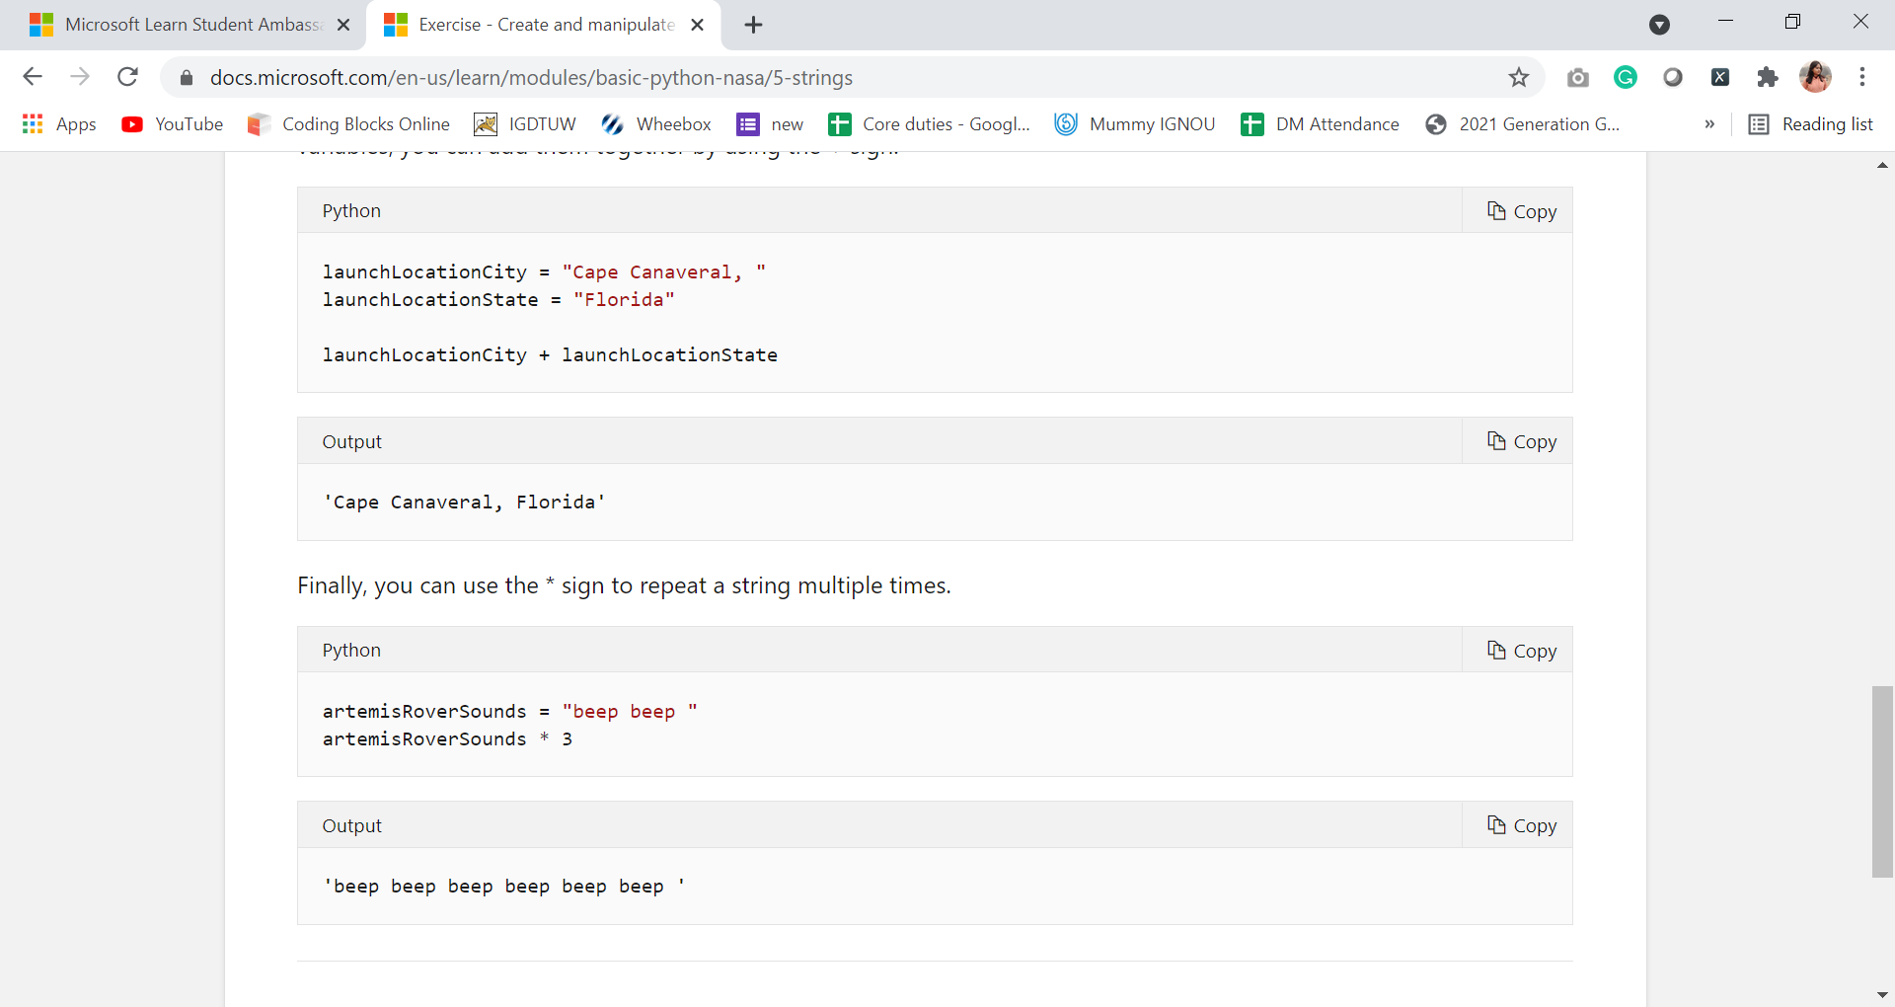

Slide 25
Create lists of data in Python code

Slide 26
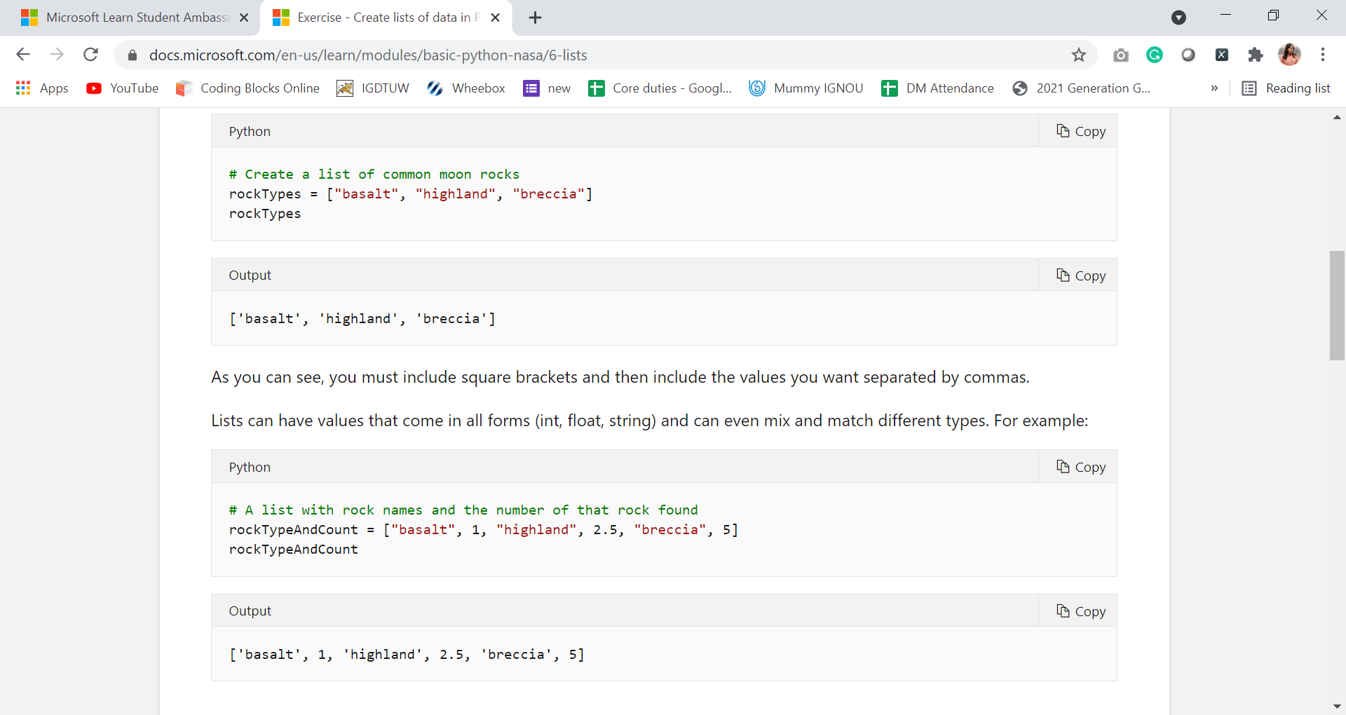
How to make a list

Slide 28
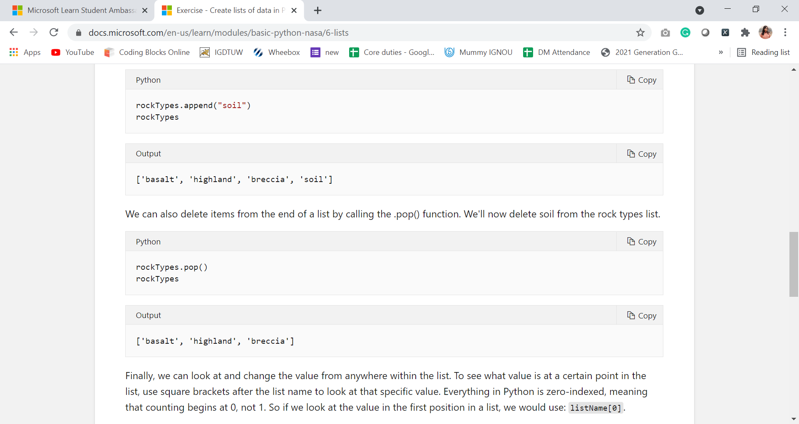
List Functions

Slide 30
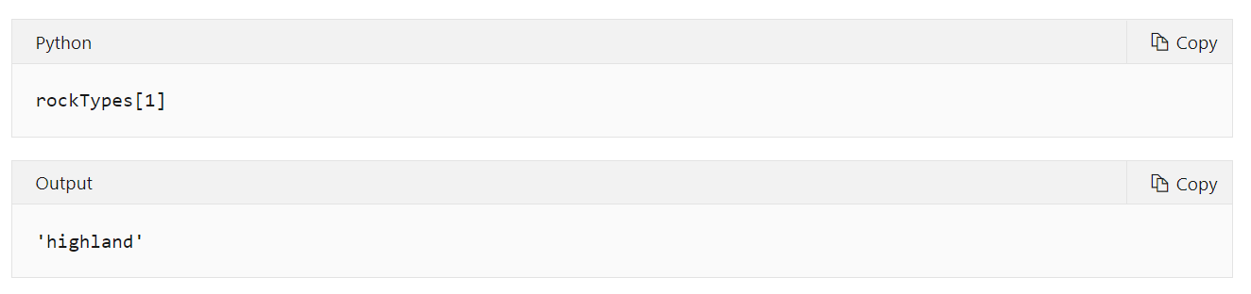

Slide 31
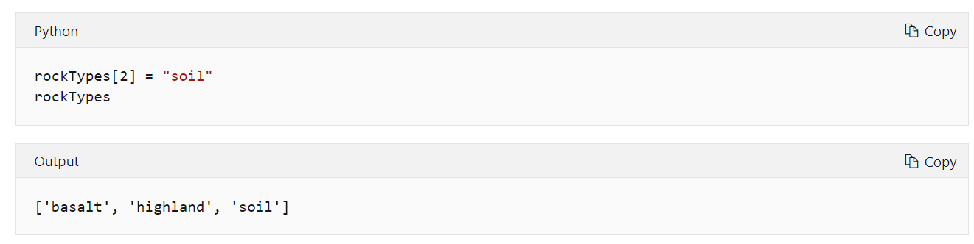

Slide 32
View results of variables and expressions in Python Notebooks

Slide 33
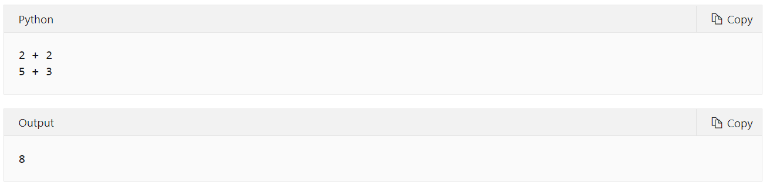

Slide 34
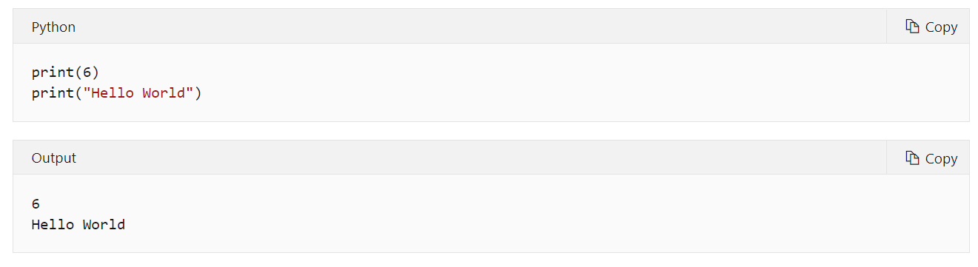

Slide 35
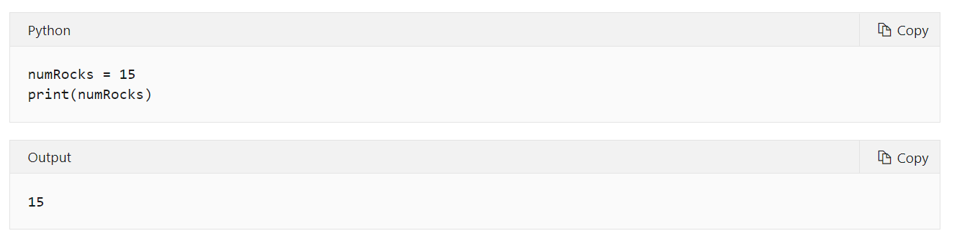

Slide 36
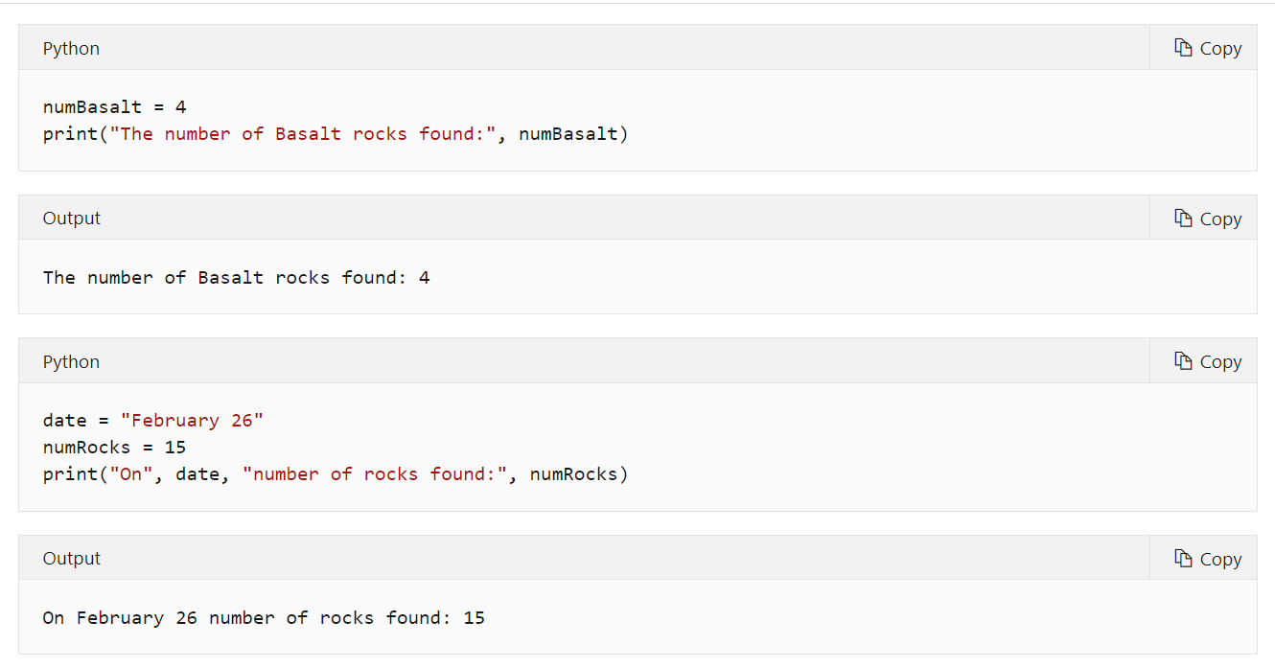

Slide 37
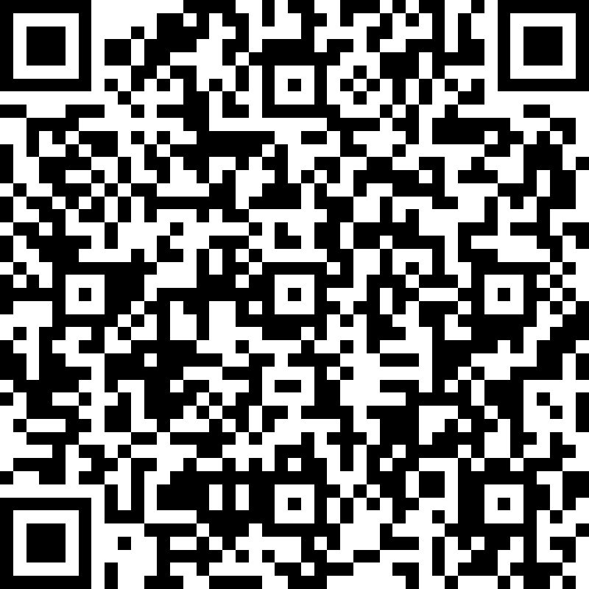
Quiz Time
https://forms.office.com/r/W9eJHysXpb

Slide 38
THANK YOU SO MUCH!!!

